Slide 1
Group meeting: Transparent Conductive Film and Micro/Submicro-Tenile tests by membrane deflection experiment (MDE)
Speaker: C. J. Lee
Date: 2009/12/23
Notes:
Sir, Dr. Du, Dr. Lai, Dr. Chen and everyone good afternoon. Today I will present and report my recent research results.
I have two research project. One is transparent conductive film. This project is a cooperative project with Dr. HK Lin of industrial technology research institute.
Another is the micro/submicro-tensile tests by membrane deflection experiment, termed MDE.

Slide 2
Outline
Micro/Submicro-tensile tests
Mechanical test methods for the thin films
Membrane deflection experiment(MDE)
Preliminary results
Prospects
Transparent conductive film
Intorduction
Experimental methods
Results
Summary and Suggestion
Notes:
Here is the outline of this presentation. Firstly, I will present the micro/submicro-tensile tests project. In the part of micro/submicro-tensile tests, I will introduce the mechanical test methods for the thin films and what is the membrane deflection experiment, MDE. Then, report the preliminary results and prospects. That is some improving plane in this project. End the micro/submicro-tensile tests part, I will also introduce the transparent conductive film project, termed TCF project. In the TCF project, firstly, I will introduce what is the transparent conductive film and how to manufacture this transparent conductive film, then report the experimental methods and results. Finally, I will make a brief summary and suggestion for this research project.

Slide 3
Transparent conductive film
What is the Transparent conductive film (TCF)?
the films with the exclusive properties of good transparency for visible light and conductivity
How to manufacture this TCF?
Generally, a transparent substrate (glass or polymer substrate) being coated some transparent conductive materials, such as Indium tin oxide(ITO), ZnO.
Application of TCF:
Flat-panel display, solar cells and electromagnetic shielding of CRTs used for video display terminals.

Slide 4
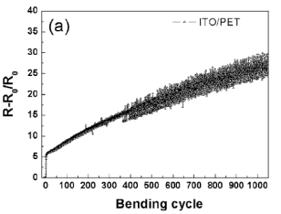
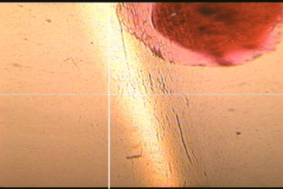
Transparent conductive film
Difficult challenge:
TCF coated on flexible substrate could maintain stable conductivity after high cycles bending or high curvature radius bending.
Purpose: fabricate a highly flexible TCF with a good reliability on conductivity
ITO/PET bending
@ D < 13 mm
Normalized resistance change after repeated
Bending as a function of the number of cycles
Standard: normalized resistance change rate < 10%
Notes:
If someone TCF are coated on flexible substrate, it will confront a big challenge of maintaining stable conductivity after high cycles bending or high curvature radius.
Because the traditional TCF, ITO will appear the crack to influence the conductivity after high cycles bending or high curvature radius. So, in this project, our purpose is fabricate the …..

Slide 5
Experimental methods
TCF structures:
Metal layer:
Pure Ag
Co-sputter Ag-Al
Co-sputter Ag-Ti
Co-sputter Cu-Zr
Alloy target: Cu₅₀Zr₅₀
ITO film (oxide film, ~30 nm)
ITO film (oxide film, ~30 nm)
Metal layer(Ag, or Amorphous metal, < 10 nm)
Metal layer(Ag, or Amorphous metal, < 10 nm)
ITO or ZnO film (oxide film, ~30 nm)
PET substrate, 125 μm
PET substrate, 125 μm
Bi-layer structure
Tri-layer structure
Notes:
Our design has two different TCF structure, one is the bi-layer structure. In this structure, the metal layer will be coated firstly, then coated the ITO film. Another structure is a sandwich structure. This structure design has been reported in many literatures. Metal layer materials will have ….

Slide 6
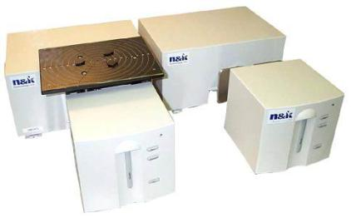
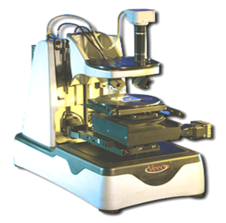
Experimental methods
Transmittance and reflectivity measurement:
Instrument: N & K analyzer
Wavelength:
Deep ultraviolet-visible-
near infrared, 190 -1000 nm,
1 nm intervals
Film thickness measurement:
Instrument: 3D alpha-step profilometer
Sheet resistance measurement:
Four point probe
Element analysis: SEM 6400 EDS
Crystalline structure examination:
X-ray diffraction, SIEMENS D5000

Slide 7
Experimental flow chart
Alloy design,
By adjusting the parameters of
co-sputtering, such as power, metal materials.
α-step
EDS
XRD
Bi-layers and Tri-layers deposition
N & K
Four point probe
Evaluation, analysis and modification

Slide 8
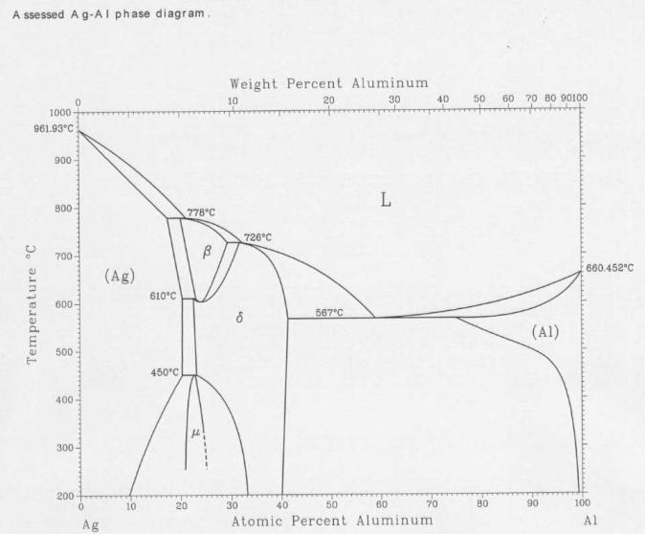
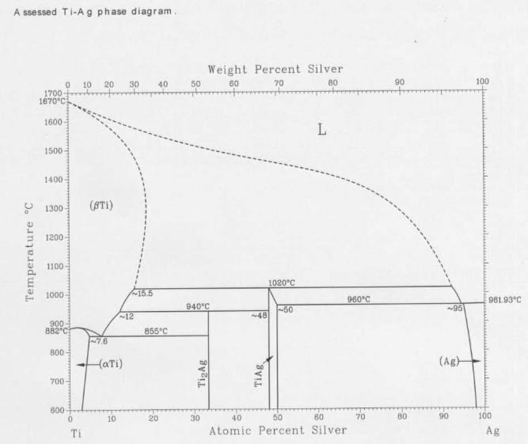
Results
Phase diagrams of Ag-Al and Ag-Ti systems
Ag-Al system
Ag-Ti system
Notes:
These two figures are Ag-Al and Ag-Ti phase diagram. From these two phase diagram, we know Ag-Al and Ag-Ti are miscible system. However, in alloy design, I hope the alloy element will be Ag as matrix.

Slide 9
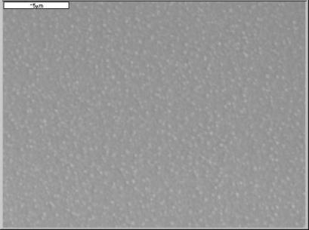
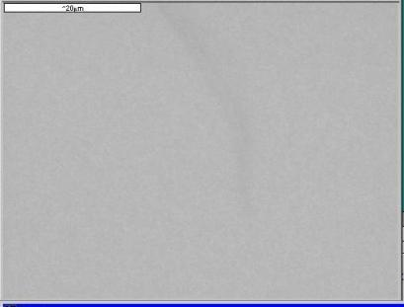
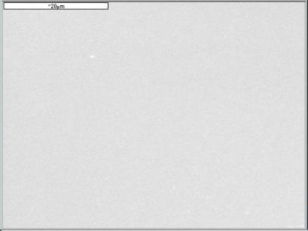
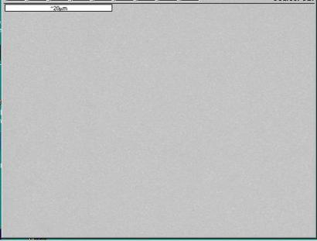

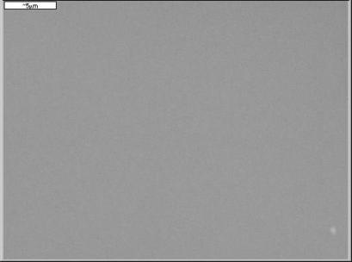
Results
Ag-Al system
Ag₈₀Al₂₀
Ag₇₁Al₂₉
Ag₆₇Al₃₃
Ag₅₇Al₄₃
Ag₄₇Al₅₃
Ag₃₀Al₇₀
Notes:
In Ag-Al co-sputtering, Ag80Al20 will precipitate some small and white particles in gray matrix. However, Ag ratio is lower than 70%, the appearance of co-sputtering films are very clear without precipitation. Very like amorphous film.

Slide 10
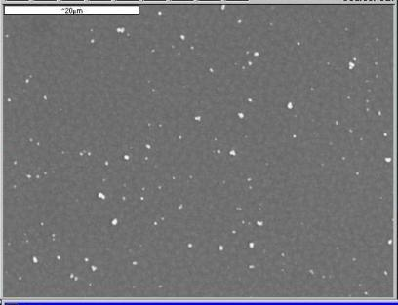
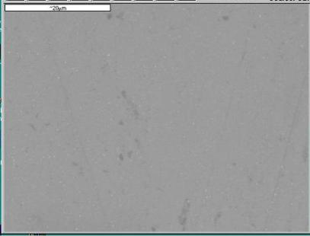
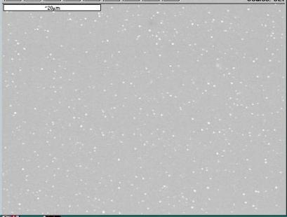
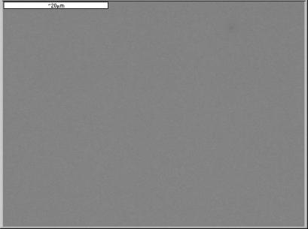
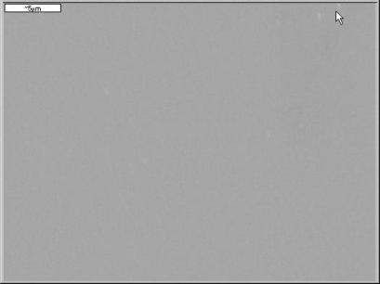
Results
Ag-Ti system
Ag₇₅Ti₂₅
Ag₇₀Ti₃₀
Ag₆₁Ti₃₉
Ag₄₈Ti₅₂
Ag₃₈Ti₆₂
Notes:
In Ag-Ti co-sputtering, Ag75Al25 precipitate many gray precipitation in black matrix. White particle may be contamination. However, Ag ratio is lower than 70%, the appearance of co-sputtering films are very clear without precipitation. Very like amorphous film.

Slide 11
Results
XRD results:
The Ag-Al system did not form the fully
amorphous except Ag₃₀Al₇₀. The crystalline
diffraction peaks of (111) and (200) planes
in Ag metal could be observed.
The Ag-Ti system did not form the fully
Amorphous. The crystalline diffraction
peaks of (111) and (200) planes in Ag
metal could be observed.

Slide 12
Results
Grain size estimation based on the peak full width at half maximum (FWHM)
Equation: , where the d is grain size, K is Scherrer constant (K=0.94 for the cubic lattices) and λ is the wave length of incident Cu Ka radiation (λ=0.154056 nm)
Alloy | Ag₇₁Al₂₉ | Ag₆₇Al₃₃ | Ag₆₄Al₃₆ | Ag₅₇Al₄₃ | Ag₄₇Al₅₃
Size, nm | 4.0 | 5.3 | 6.2 | 3.6 | 2.8
Alloy | Ag₇₅Ti₂₅ | Ag₇₀Ti₃₀ | Ag₆₁Ti₃₉ | Ag₄₈Ti₅₂
Size, nm | 30 | 8.4 | 5.1 | 4.5

Slide 13
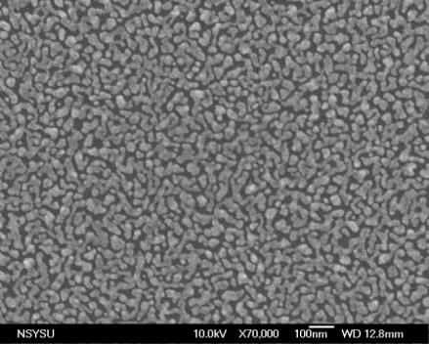
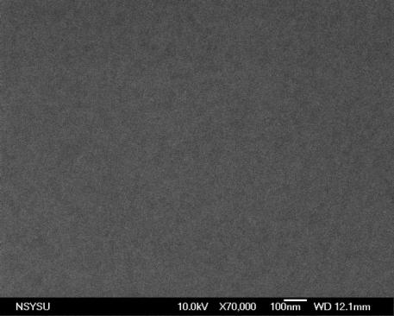
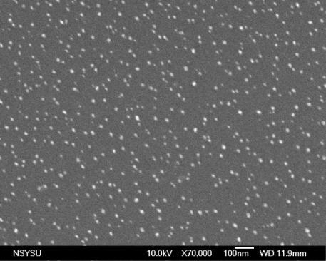
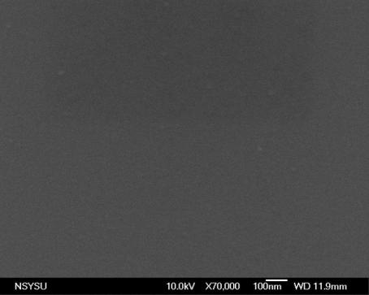
Results
3 nm metal film coated on Si substrate
Pure Ag
Ag₄₇Al₅₃
Ag₄₈Ti₅₂
Zr₅₄Cu₄₆
Notes:
Pure Ag deposition with 3 nm thickness, the morphology is island structure. However, Ag-Al, Ag-Ti and ZrCu are continuous film.

Slide 14
Results, optical properties
Bi-layers, 3 nm
Bi-layers, 6 nm
Tri-layers

Slide 15
Results, optical properties
At 550 nm wavelength
Specimen, Bi-layers, 3 nm | Transmittance, % | Specimen, Bi-layers, 6 nm | Transmittance, % | Specimen, Tri-layers, | Transmittance, %
PET | 86 | PET | 86 | PET | 86
ITO, 30 nm | 79 | ITO, 30 nm | 79 | I+Ag(3)+I | 54
Ag + I | 59 | Ag +I | 72 | I+Ag(6)+I | 75
Ag₄₇Al₅₃ + I | 50 | Ag₄₇Al₅₃ + I | 47 | I+AgAl(3)+I | 57
Ag₄₈Ti₅₂ + I | 55 | Ag₄₈Ti₅₂ + I | 48 | I+AgTi(3)+I | 50
Zr₅₄Cu₄₆ + I | 79 | Zr₅₄Cu₄₆ + I | 64 | I+ZrCu(3)+I | 71
Notes:
This table compiles the transmittance at 550 nm visible wavelength for these different TCF.

Slide 16
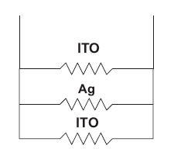
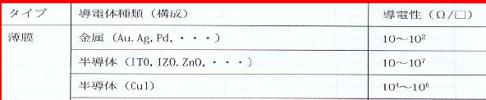

Results, electrical properties
Specimen, Bi-layers, 3 nm | Sheet resistance, Ω/□ | Specimen, Bi-layers, 6 nm | Sheet resistance, Ω/□ | Specimen, Tri-layers, | Sheet resistance, Ω/□
ITO, 30 nm | 3.7 K | ITO, 30 nm | 3.7 K | I+Ag(3)+I | 70
Ag + I | 42 | Ag +I | 3 | I+Ag(6)+I | 3
Ag₄₇Al₅₃ + I | 340 K | Ag₄₇Al₅₃ + I | 260 K | I+AgAl(3)+I | 4.4 K
Ag₄₈Ti₅₂ + I | 43 K | Ag₄₈Ti₅₂ + I | 300 K | I+AgTi(3)+I | 393
Zr₅₄Cu₄₆ + I | 250 K | Zr₅₄Cu₄₆ + I | 411 | I+ZrCu(3)+I | 1.9 K
Four probes measurement: Parallel Connection
Conductivity of bi-layer more than 3.7 K Ω/ □ will be unreasonable

Slide 17
Process map
Specimen | ITO, Parametrer: Power(working pressure) | Metal film, Parameter: Power(working pressure) | ITO, Parametrer: Power(working pressure) | Square resistivity, Ω/□
PET+ITO(30 nm) | 150 W(8 mtorr), RF |  |  | 3700
Ag(3 nm)+ITO | xx | 80 W(4 motrr), RF | 150 W(8 mtorr), RF | 42
Ag(6 nm)+ITO | xx | 80 W(4 motrr), RF | 150 W(8 mtorr), RF | 3
Ag₄₇Al₅₃ (3nm)+ITO | xx | Ag: 40 W(4 mtorr), RF Al: 150 W(4 mtorr), DC | 150 W(8 mtorr), RF | 340000
Ag₄₇Al₅₃ (6nm)+ITO | xx | Ag: 40 W(4 mtorr), RF Al: 150 W(4 mtorr), DC | 150 W(8 mtorr), RF | 260000
Ag₄₈Ti₅₂ (3nm)+ITO | xx | Ag: 30 W(4 mtorr), RF Ti: 200 W(4 mtorr), DC | 150 W(8 mtorr), RF | 43000
Ag₄₈Ti₅₂ (6nm)+ITO | xx | Ag: 30 W(4 mtorr), RF Ti: 200 W(4 mtorr), DC | 150 W(8 mtorr), RF | 300000
Zr₅₄Cu₄₆(3 nm)+ITO | xx | Cu: 84 W(4 mtorr), RF Zr: 140 W(4 mtorr), DC | 150 W(8 mtorr), RF | 250000
Zr₅₄Cu₄₆(6 nm)+ITO | xx | Cu: 84 W(4 mtorr), RF Zr: 140 W(4 mtorr), DC | 150 W(8 mtorr), RF | 411
ITO+Ag(3 nm)+ITO | 150 W(8 mtorr), RF | 80 W(4 motrr), RF | 150 W(8 mtorr), RF | 70
ITO+Ag(6 nm)+ITO | 150 W(8 mtorr), RF | 80 W(4 motrr), RF | 150 W(8 mtorr), RF | 3
ITO+Ag₄₇Al₅₃(3 nm)+ITO | 150 W(8 mtorr), RF | Ag: 40 W(4 mtorr), RF Al: 150 W(4 mtorr), DC | 150 W(8 mtorr), RF | 4400
ITO+Ag₄₇Ti₅₃(3 nm)+ITO | 150 W(8 mtorr), RF | Ag: 30 W(4 mtorr), RF Ti: 200 W(4 mtorr), DC | 150 W(8 mtorr), RF | 393
ITO+Zr₅₄Cu₄₆(3 nm)+ITO | 150 W(8 mtorr), RF | Cu: 84 W(4 mtorr), RF Zr: 140 W(4 mtorr), DC | 150 W(8 mtorr), RF | 1900
: Best
: Superior
: Good
: Worse

Slide 18
Common characteristics
Best: First layer is RF gun and lower power,
ex: Ag(3 or 6 nm)+ITO
Superior: First layer is the lower power at RF or DC
gun and thicker
ex: ZrCu( 6 nm)+ITO
Worse: First layer is the higher power at DC gun
ex: AgAl( 3 nm)+ITO

Slide 19
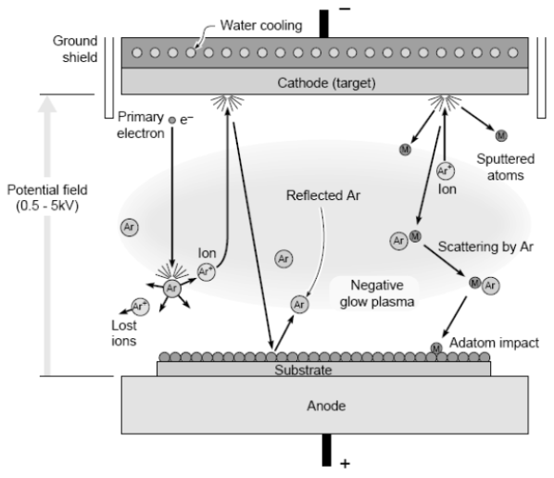
Sputter mechanism
At high powers, the substrate surface, especially of organic substrate, is damaged by the bombardment of the substrate by energetic particles.
High power damage of organic substrate surface will induce the discontinuous films to result in the increasing of resistance.
Notes:
Sputter deposition is a method, employing the Ar atom ionization in plasma, therefore,

Slide 20
Zr₅₀Cu₅₀ alloy deposition
Depositing Zr₅₀Cu₅₀ alloy target: 30 sccm Ar, 4 mtorr, 40 W, base pressure < 2x10⁻⁵ Pa
Depositing ITO_L parameters: 50 sccm Ar, 8 mtorr, 80 W, base < 2x10⁻⁵ Pa
Depositing ITO parameters: 50 sccm Ar, 8 mtorr, 150 W, base < 2x10-5 Pa
Bi-layer structure

Slide 21
Transmittance and electrical properties of Zr₅₀Cu₅₀ film
Specimen | Transmitance, % at 550 nm | Sheet resistance, Ω/□ | Specimen | Transmittance, % at 550 nm | Sheet resistance, Ω/□
ITO_L | 80 | 21K | ITO | 79 | 3.7 K
3 nm ZrCu+ITO_L | 79 | 32 K
6 nm ZrCu+ITO_L | 78 | 22 K | 6 nm ZrCu+ITO | 76 | 1.5 K
9 nm ZrCu+ITO_L | 80 | 3.3 K | 9 nm ZrCu+ITO | 63 | 3.3 K
12 nm ZrCu+ITO_L | 80 | 5.2 K
15 nm ZrCu+ITO_L | 80 | 488 K
21 nm ZrCu+ITO_L | 60 | 26 K

Slide 22
Summary
The co-sputtering of Ag-Al and Ag-Ti alloys can not form the fully amorphous of silver matrix.
The Ag metallic film showed the good transmittance and conductivity in the TCF of bi-layers and tri-layers structures.
The co-sputtering Zr₅₄Cu₄₆ amorphous film exhibited the better transmittance and conductivity than other co-sputtering AgAl and AgTi metallic films in the bi-layers TCF.

Slide 23
Summary
The higher power of sputtering should be avoided in order not to damage the surface of organic substrate during coating the first layer film.
The Zr₅₀Cu₅₀ amorphous film, using the ZrCu alloy target, could perform the best transmittance in the TCF of bi-layers structure

Slide 24
Future work and suggestion
The Good parameters of sputtering ITO film should be further studied to make the film perform the superior transmittance and conductivity.
The co-sputtering Ag-X films should be worthy to research based on pure science perspective.
The evaporation or E-beam evaporation might be an appropriate processing route.
The cycle bending and small curvature bending will be conducted in ITRI

Slide 25
Acknowledgement
I would like greatly acknowledge the help of S. Y. Sun in wet-etching, lift-off process, nano-indentation, sputtering, resistance measurement, and other miscellaneous things.
I would also acknowledge the help of Laiyen in designing the mask pattern, lift-off process, and the help of H.M. Chen in lift-off process and wet-etching.

